Slide 1
GSO Training

Slide 2
What is the GSA?
GSA Executive Council
Office of Graduate Student Life
Elected by the Senate
President
Vice President
Treasurer
Historian
Standing Committee Chairs
Graduate Assistants
Community Liaison
Communications Manager
Writing Advisor
GSA Executive Administrative Assistant
Advises Executive Board
Supervises the OGSL Staff

Slide 3
GSA Senate
Meets monthly: Second week of Every Month
16 Senators made from 4 groups:
CAHSS (College of Arts, Humanities and Social Sciences)
COEIT (College of Engineering and Information Technology)
CNMS (College of Natural and Mathematical Sciences)
Non-Academic (cultural, professional development and other non-academically inclined GSOs)
Votes on GSA policies, budgets, and programs

Slide 4
Graduate Student Organizations
Established in the GSA Constitution, By-Laws and PoP
Funded in the GSA budget, which comes from graduate student fees
New GSOs can be formed at any time
GSOs must register each year
New policy: GSOs are not required to attend GSA Senate meetings

Slide 5
POLICY INFORMATION
All GSOs (who have not been newly created) must be registered by September 20th to be eligible for funding for the 2021-2022 academic year
All funding will be reviewed and approved by the Grants Review Panel
To request funding, fill out an Allocation Request form and the Community Liaison will be in touch with you regarding your approval
The total GSO budget for FY 22 is $20,000 for all active GSOs

Slide 6
Three Steps for Success
1. Stay Active and Recognized!
2. Event Approval and Planning
3. Payments and Reimbursement

Slide 7
Stay Active and Recognized
If you have not, please complete the online registration form
Apply for funding via Allocation Request Forms
Share GSA information at GSO meetings and events

Slide 8
Approval and Planning
Check out our Event planning Page for more info!
Submit an allocation request form online
Approval will be emailed to you after your request is approved by the GRP
Must have approval for your event before you submit for reimbursement
Plan your event
Arrange to make purchases for events (you can be reimbursed)
Submit liability forms if your event is off-campus
Contact a caterer if needed
Reserve Space in 25Live
Put in a Request (only 2 contacts from each group will have access)
All requests must be set up through 25Live AT LEAST 3 DAYS IN ADVANCE

Slide 9
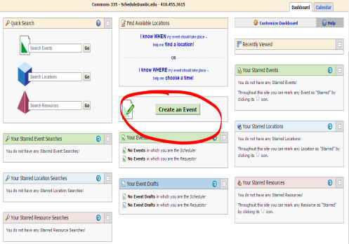
25Live Online Scheduler
Sign in using your myUMBC information
Create an Event
Search for your GSO or Program name
When prompted for a chart string number, write “GSA sponsored event”
Scheduling will email confirmation to your UMBC email

Slide 10
Payments and Reimbursements
Submit post-event forms
Post event form with payee information included
All original, itemized receipts and invoices
A flyer or e-mail advertising the event
Sign-in sheet of ALL attendees
Submit 25Live confirmation from scheduling
If necessary:
Submit Google Map directions (mileage reimbursement at $.58 per mile)
If off-campus: ALL liability forms from all UMBC students (link to liability forms will be in approval email, electronic signatures acceptable)

Slide 11
Updates
Extravagant Expenses
GSA Executive Council has the right to review approval of funds if the expenditures are thought to be excessive
For reimbursement purposes, restaurant meals have the following per person limits:
Breakfast $13
Lunch $15
Dinner $28
Estimated Attendance will be considered when approving events
Out-of-State or Overnight Travel
Accounting requires e-travel forms
Must submit names, travel dates, departure and destination locations, and mode of transportation

Slide 12
Processing Your Documents
Once completed and approved by Community Liaison and Executive Administrative Assistant, all reimbursements are processed online
Caterers are paid directly – Send invoices to GSA
Particular Items must be shown on all paperwork
Allow 4-6 weeks for payment
Delivered via check to your address OR
If Direct Deposit: “State of MD- Vendor Payment”

Slide 13
Running your GSO
Having regular meetings throughout the year
Reporting student issues
Contact with students, GPDs and GPCs
Advertising your events and services
Collaborating on events/initiatives with other departments or GSOs
Any questions/concerns/ideas?

Slide 14
Contact Info
Zane Poffenberger
GSA Community Liaison
zpoff2@umbc.edu
gsa@umbc.edu
(In subject line include “Attn: Zane/Community Liaison”)
GSA Office Hours
Monday- Thursday*
9:00a.m.- 4:00 p.m.
410-455-2773
* The GSA Community Liaison will be in on Mondays and Wednesdays and available via email on Thursdays. Feel free to schedule a specific time and day to meet.

